Slide 1


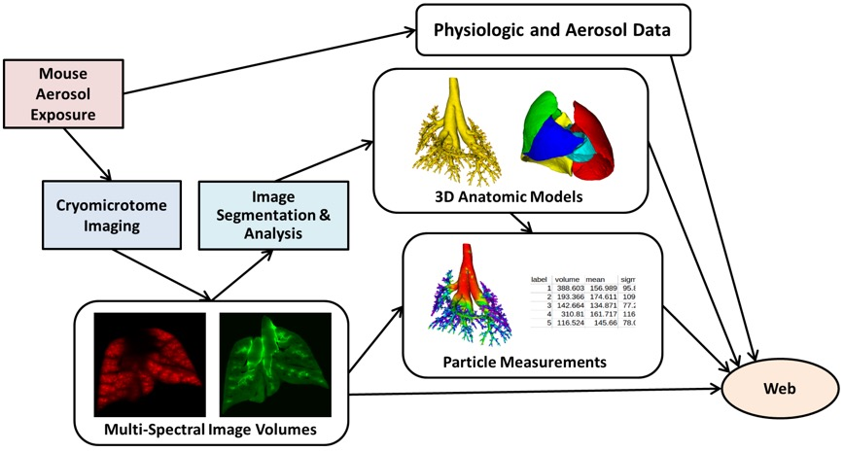

Slide 2
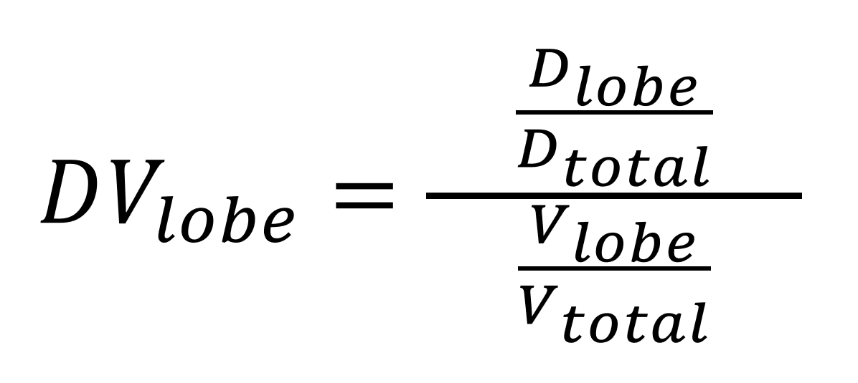

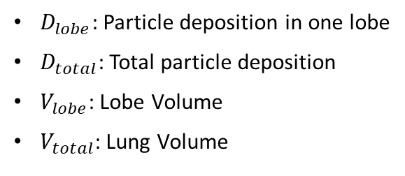
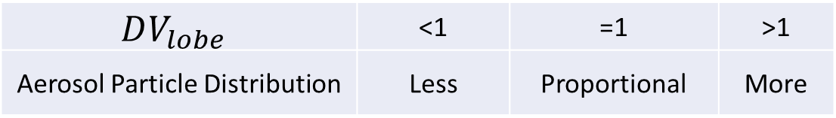
Introduction to the LAPD dataset
Mice samples are exposed to aerosol with particle size 0.5 μm, 1 μm and 2 μm
Full dataset is consisted of 33 samples
There are 4 strains of mice in the dataset
For each lobe, the ratio between normalized lobar deposition and volume is denoted as $DV_{lobe}$
$D_{lobe}$: Particle deposition in one lobe
$D_{total}$: Total particle deposition
$V_{lobe}$: Lobe Volume
$V_{total}$: Lung Volume
$$DV_{lobe}$$ | <1 | =1 | >1
Aerosol Particle Distribution | Less | Proportional | More
Notes:
Looking at Lobar deposition
Look at ratio of DV (Normalized D/V)
If less than 1, equal 1 and more than 1
Use the newest graphs from the finalized values
What is the significance

Slide 3

Introduction to the LAPD dataset
Mice samples are exposed to aerosol with particle size 0.5 μm, 1 μm and 2 μm
Full dataset is consisted of 33 samples
There are 4 strains of mice in the dataset
For each lobe, the ratio between normalized lobar deposition and volume is denoted as $DV_{lobe}$
$D_{lobe}$: Particle deposition in one lobe
$D_{total}$: Total particle deposition
$V_{lobe}$: Lobe Volume
$V_{total}$: Lung Volume
$$DV_{lobe}$$ | <1 | =1 | >1
Aerosol Particle Distribution | Less | Proportional | More
Notes:
Looking at Lobar deposition
Look at ratio of DV (Normalized D/V)
If less than 1, equal 1 and more than 1
Use the newest graphs from the finalized values
What is the significance

Slide 4

Introduction to the LAPD dataset
Mice samples are exposed to aerosol with particle size 0.5 μm, 1 μm and 2 μm
Full dataset is consisted of 33 samples
There are 4 strains of mice in the dataset
For each lobe, the ratio between normalized lobar deposition and volume is denoted as $DV_{lobe}$
$D_{lobe}$: Particle deposition in one lobe
$D_{total}$: Total particle deposition
$V_{lobe}$: Lobe Volume
$V_{total}$: Lung Volume
$$DV_{lobe}$$ | <1 | =1 | >1
Aerosol Particle Distribution | Less | Proportional | More
Notes:
Looking at Lobar deposition
Look at ratio of DV (Normalized D/V)
If less than 1, equal 1 and more than 1
Use the newest graphs from the finalized values
What is the significance

Slide 5

Introduction to the LAPD dataset
Mice samples are exposed to aerosol with particle size 0.5 μm, 1 μm and 2 μm
Full dataset is consisted of 33 samples
There are 4 strains of mice in the dataset
For each lobe, the ratio between normalized lobar deposition and volume is denoted as $DV_{lobe}$
$D_{lobe}$: Particle deposition in one lobe
$D_{total}$: Total particle deposition
$V_{lobe}$: Lobe Volume
$V_{total}$: Lung Volume
$$DV_{lobe}$$ | <1 | =1 | >1
Aerosol Particle Distribution | Less | Proportional | More
Notes:
Looking at Lobar deposition
Look at ratio of DV (Normalized D/V)
If less than 1, equal 1 and more than 1
Use the newest graphs from the finalized values
What is the significance

Slide 6
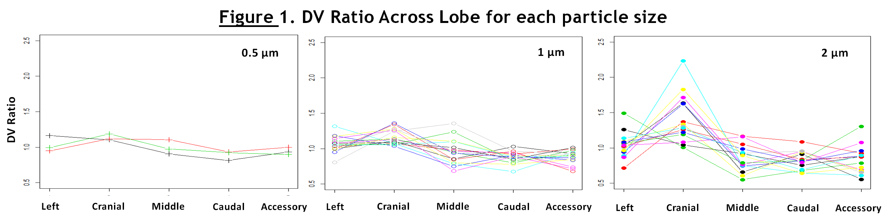
Heterogeneity in Lobar Deposition Increases with Increasing Particle Size
Heterogeneity increases with increasing Particle Size
Analysis of particle deposition in single lobes will either underestimate or overestimate the particle deposition in the whole lung
Notes:
Talk about finding
Variability of particle deposition increases as PS increases
Some lobes receive more but some receive less
There is a correlation between particle size and deposition density

Slide 7
Heterogeneity in Lobar Deposition Increases with Increasing Particle Size
Heterogeneity increases with increasing Particle Size
Analysis of particle deposition in single lobes will either underestimate or overestimate the particle deposition in the whole lung

Slide 8
Heterogeneity in Lobar Deposition Increases with Increasing Particle Size
Heterogeneity increases with increasing Particle Size
Analysis of particle deposition in single lobes will either underestimate or overestimate the particle deposition in the whole lung

